Slide 1

Twitter Sentiment Analysis & Search
Kieyn Park (kieynp2), Lavanya Rao (lrao3)
Sarang Deotale(deotale2)

Slide 2
Project Overview
Problem definition – Twitter is very popular microblogging and social networking service across the masses, it can create various sentiments among masses, this project is to search tweets on topic and ID, also to identify what sentiment categories of tweets.

Slide 3
High level Design
General approach
Search User Interface
Tweet Data Files
Search
Tweet
Servers
Tweet Scrapper
Ranker & Index
Ranked search result
------
------
-------
Tweet Data Files
------
------
-------
Sentiment Analysis

Slide 4
Installation Guide
Unzip the Final Project.zip
Example on Linux – unzip Final Project.zip
It will create folder structure for program file, data files, and index files
Install metapy, tweepy, textblob
Run below commands
$ module load python3
$pip install metapy pytoml –user
$pip install textblob –user
$pip install tweepy –user
Create Twitter developer account, application and authentication credential
* Python 3 assumed to be installed to run this project

Slide 5
User Guide
Collect the tweet data (Optional Step)
Run TwitterScrapText.py (this is optional steps, the folder has previously scrapped data)
It will create text files having scrapped tweets with Health, Beauty, Sports, News and Technology topic, two options can be used, continuous collection of tweets, or batch of tweets (Note – for this project 10,000 tweets from each category is collected
* Note – Twitter security handler needs special setup, developer account and application creation and authentication creation. Follow instruction on tweet developer website
UI for Search and Sentiment analysis
Run searchgui.py
It will create inverse index on the collected tweets, this will be done only first time
Perform search with ID, Topic, sentiment analysis.

Slide 6


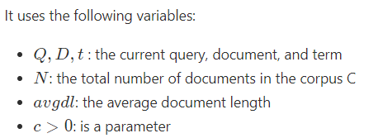
Search retrieval function
The retrieval function: InL2

Slide 7
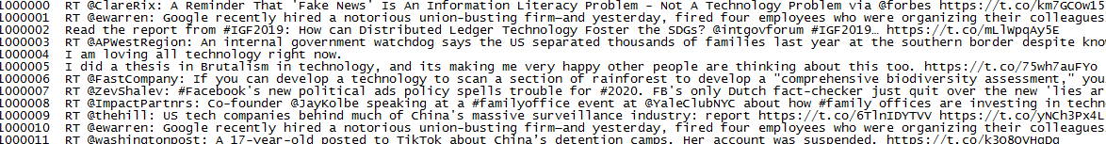
Results
1. Collect the Tweets

Slide 8
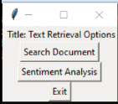
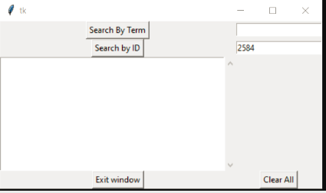
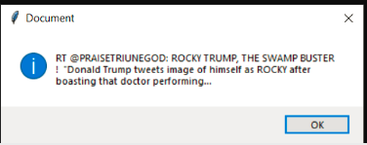
Results
2. Search the tweets by ID

Slide 9
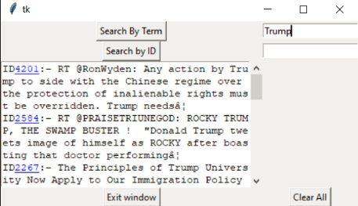
Results
3. Search the tweets by Topic

Slide 10
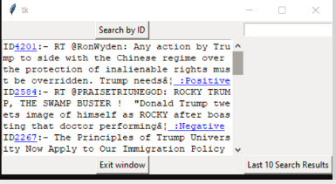
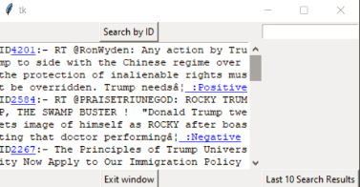
Results
4. Sentiment Analysis

